Slide 1



Student Management System Report
View in Power BI
Last data refresh:
12/8/2025 1:00:10 PM UTC
Downloaded at:
12/8/2025 1:05:32 PM UTC

Slide 2
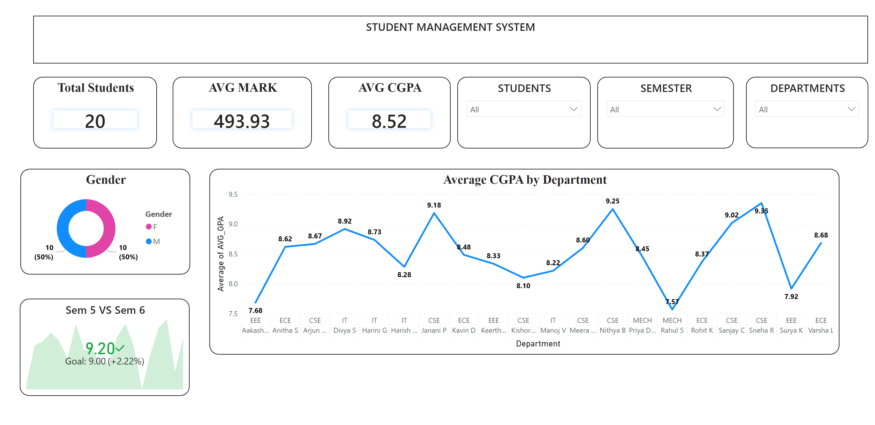
OVERVIEW
Notes:
textbox
No alt text provided
Total Students
No alt text provided
AVG CGPA
No alt text provided
AVG MARK
No alt text provided
Gender
No alt text provided
Average CGPA by Department
No alt text provided
STUDENTS
No alt text provided
DEPARTMENTS
No alt text provided
Sem 5 VS Sem 6
No alt text provided
SEMESTER
No alt text provided

